Slide 1

DEPARTMENT OF ELECTRONICS AND COMMUNICATION ENGINEERING
M
Prediction of Students Performance on Virtual Platform Using Machine Learning Algorithms
Under the esteemed guidance of
M
m Dr.S V N Sreenivasu M.Tech,Ph.D Professor
Team Members
1.D.Vamsika-19471A05K8
2.Y.Anjani Priya-19471A05P3
3.Sk.Sameena-19471A05O8
4.R.Chaitra-19471A05O3

Slide 2
ABSTRACT
Online learning platforms such as Massive Open Online Course (MOOC), Virtual Learning Environments (VLEs), and Learning Management Systems (LMS) facilitate thousands or even millions of students to learn according to their interests without spatial and temporal constraints. Besides many advantages, online learning platforms face several challenges such as students’ lack of interest, high dropouts, low engagement, students’ self-regulated behavior, and compelling students to take responsibility for settings their own goals. In this study, we propose a predictive model that analyzes the problems faced by a trisk students, subsequently, facilitating instructors for timely intervention to persuade students to increase their study engagements and improve their study performance. The predictive model is trained and tested using various machine learning (ML) to characterize the learning behavior of students according to their study variables. The predictive model can help instructors in identifying at-risk students early in the course for timely intervention thus avoiding student dropouts.

Slide 3
CONTENT
Introduction
Requirements
Proposed System
Conclusion

Slide 4
INTRODUCTION
The advancement of technology in online learning platforms made access to education easy and affordable.
Earlier the data is generated from online learning platforms is stored in the database record that can help instructors to know the performance of students in the future
The Challenging task is to predicate the learning behavior of performance at an early stage by analyzing the data.
Predictive model presents the students that are likely to quit their study and facilitating instructors to come up with preventive measures before dropout behavior occurs.
By the emergence of ML techniques,researchers study different variables that significantly affect the students dropout.

Slide 5
Software Requirements
Browser : Any latest browser like Chrome Operating
System : Window 10
Language : Python
Platform : GoogleCOLAB
Hardware Requirements
Processor : Intel(R) Core™2 i7-5500U CPU @2.50GHz
Speed : 2.4GHZ
RAM : 8GB
System Type : 64-bit operating system, x64-based processor

Slide 6
PROPOSED SYSTEM
By Using this Proposed System we can reduce the errors, enhance student performance correctly by dividing the course length into different categories .
In this, proposed a predictive model that analyzes the problems faced by at-Risk students, to persuade students to improve their study performance.
For the earliest possible prediction of students performance, divide the course length into 20%,40%,60%,80% and 100% of course completed.
To predict students’ performance at different types of course module, several factors were created like score, Number of late submissions , Assessment Scores , students VLE interaction i.e , sum clicks and mean clicks.

Slide 7
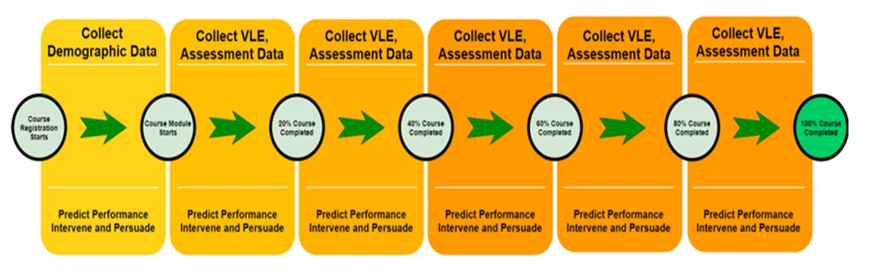
Predicting and intervening at-risk students at different percentages of the course length

Slide 8
The proposed method for the project is explained on 7 steps :
System Architecture
Raw Data
Data Importing
Data Visualization
Testing Data
Algorithm
Output Screens

Slide 9
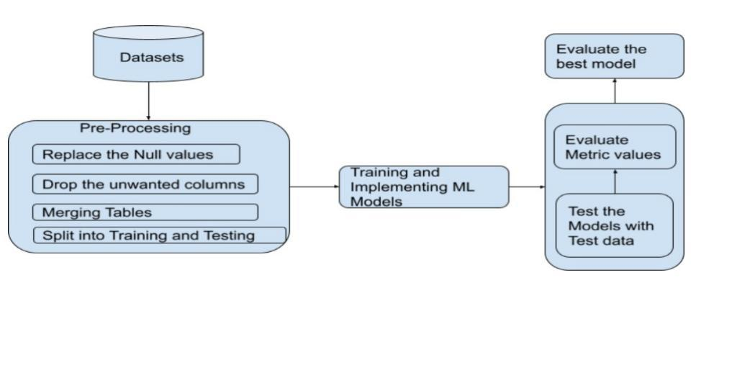
Fig 1: System Architecture

Slide 10
DATASET :
We are taken the datasets from Open University Learning Analytics Dataset (OULAD), it is provided by the Open University.
It contain the details of demographics(Student info & registration), students’ Virtual Learning Environment (VLE) interaction, assessments, course registration, and courses offered.
Students’ assessment scores are stored in a dataset triplet called student-module presentation.
The OULAD was generated for the year 2013 and 2014 containing 7 courses, 22 module-presentations with 32,593 registered students.
The datasets are taken from the mentioned link: https://www.kaggle.com/datasets/vjcalling/ouladdata

Slide 11
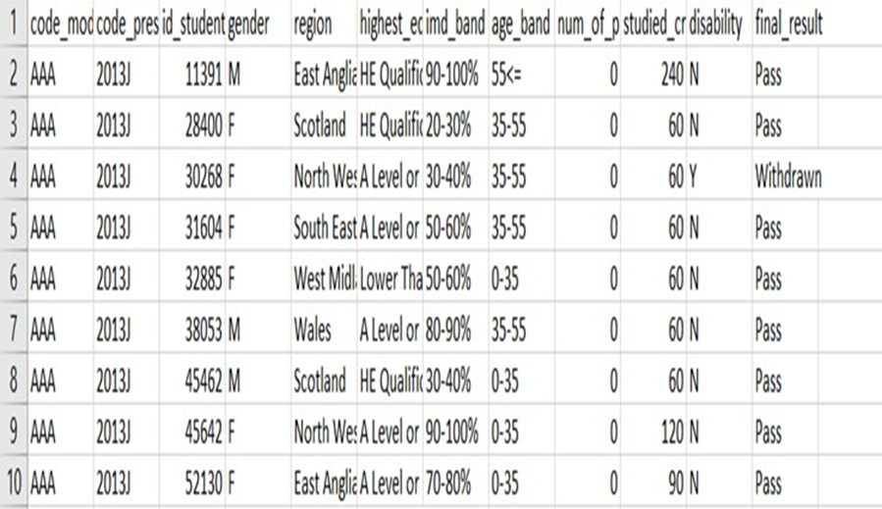
Fig 2: Dataset

Slide 12
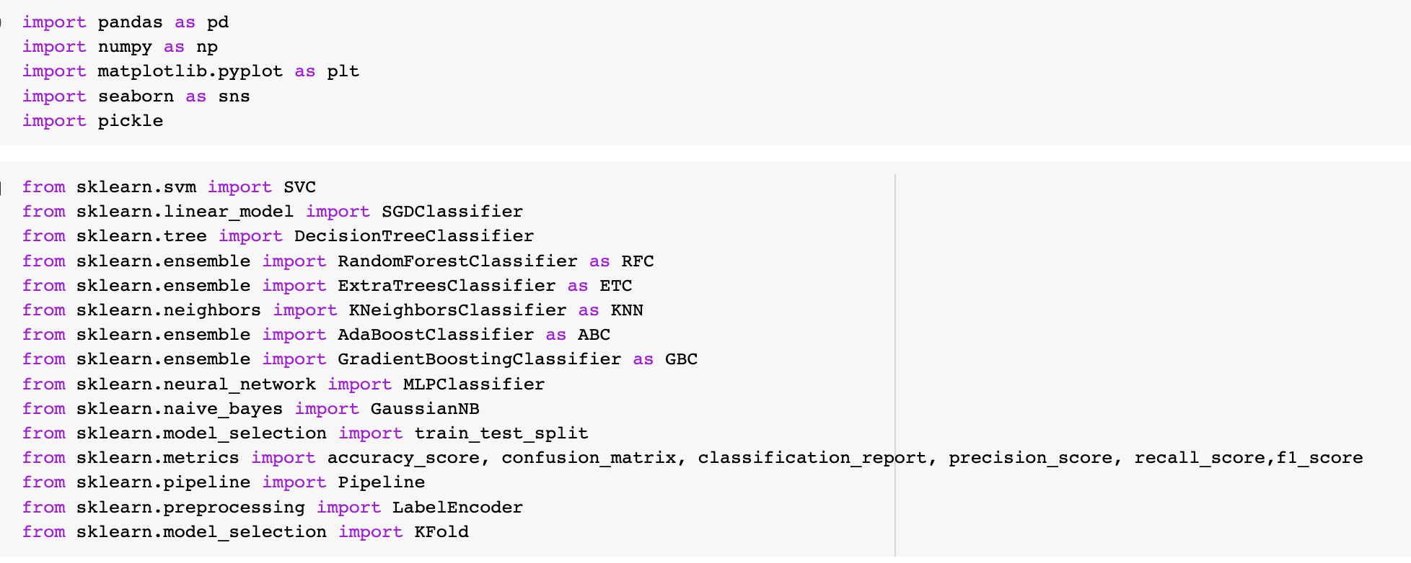
Fig 3 Importing the Modules

Slide 13
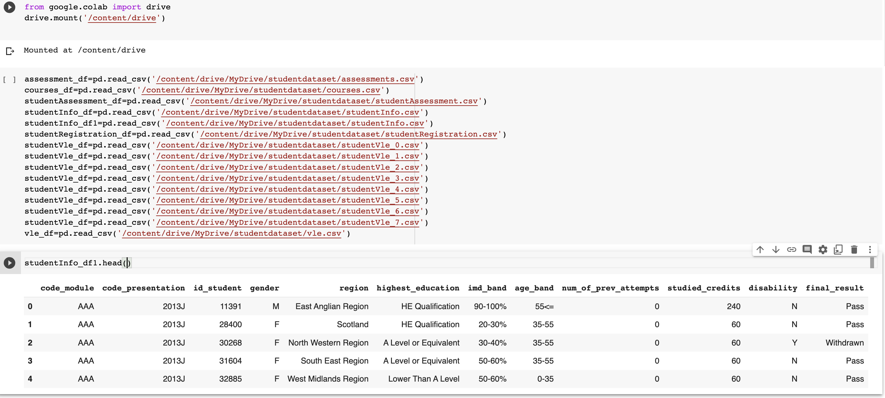
Fig 3.1 Reading the Dataset

Slide 14
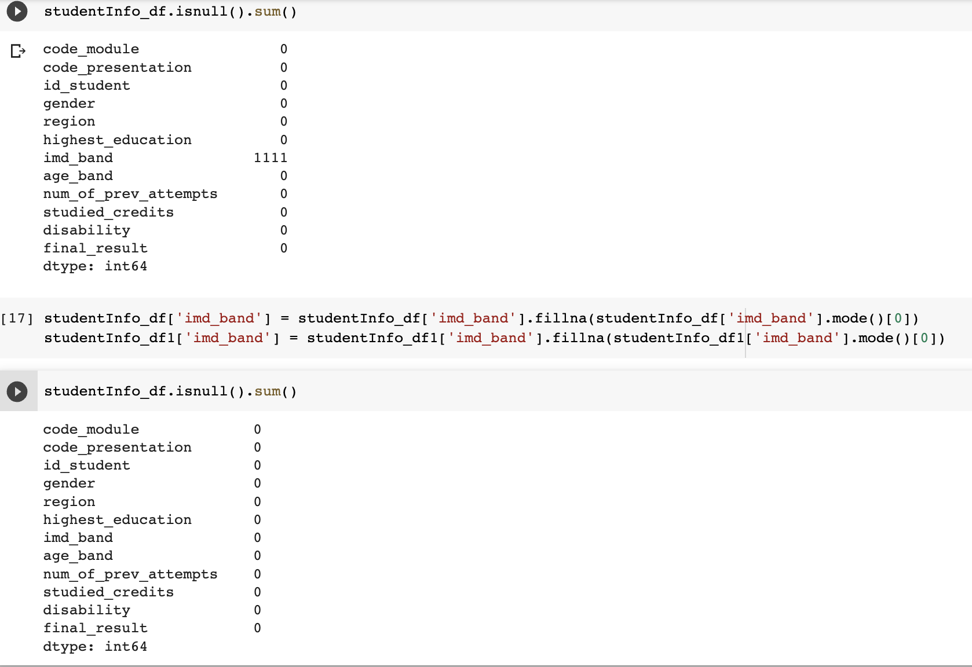
Fig 4 Checking null values and info of the dataset

Slide 15
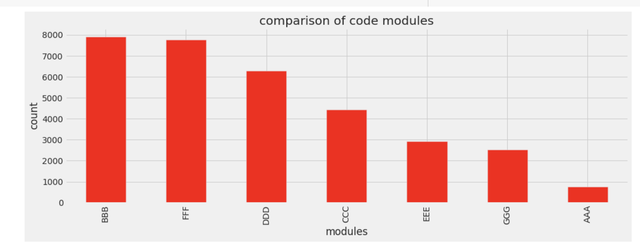
Fig 5 Comparison of Course Modules

Slide 16
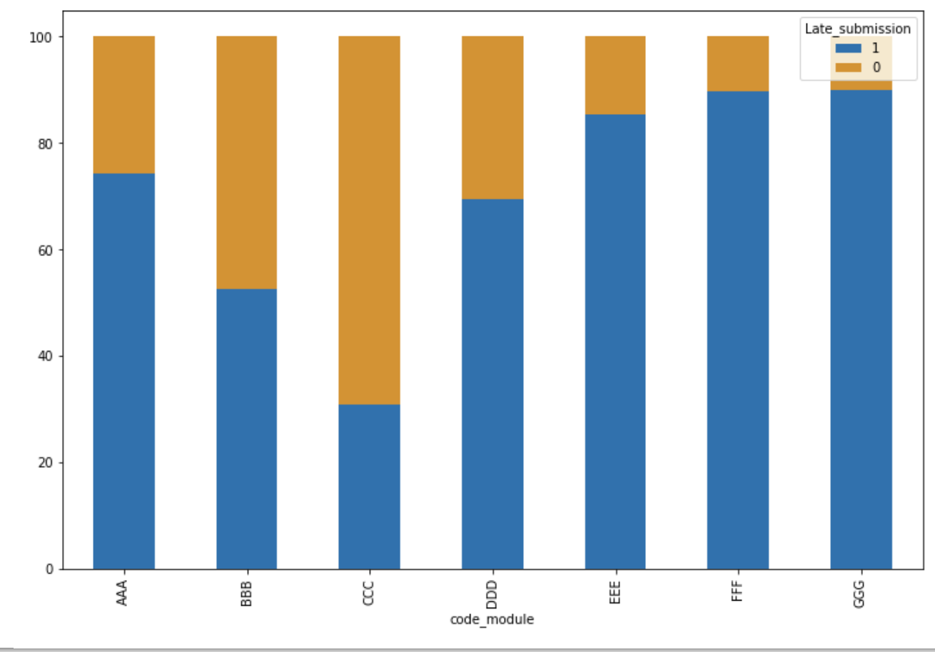
Fig 6 Late Submission Of assignments

Slide 17
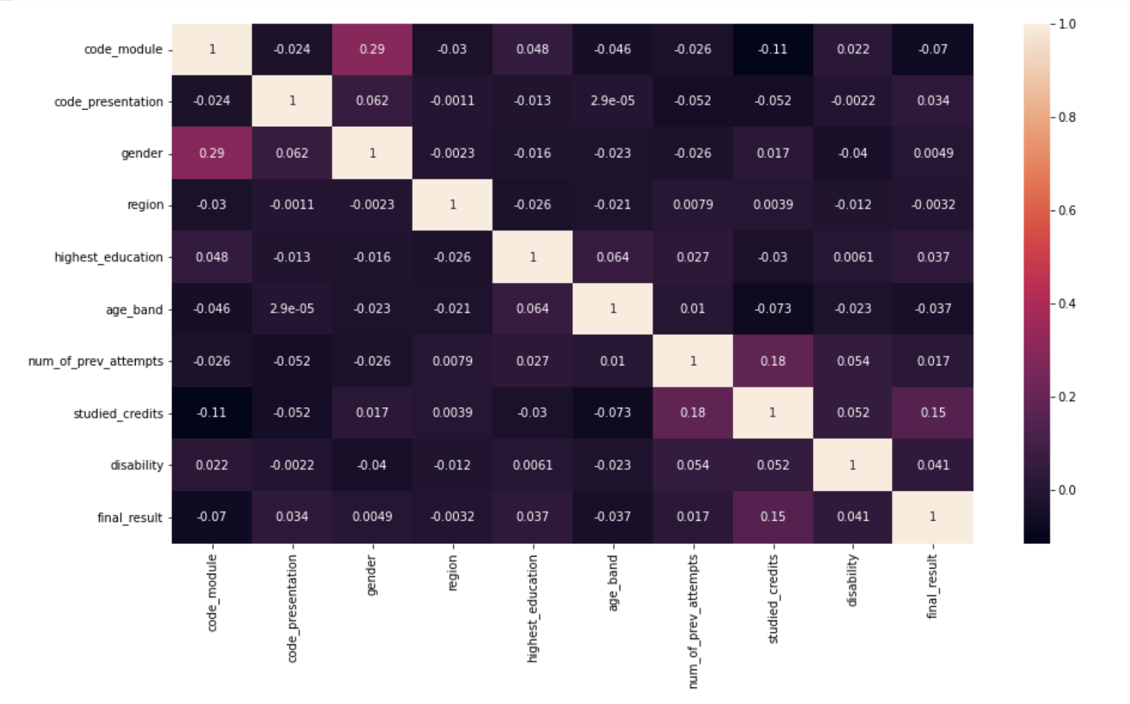
Fig 7 Corelation

Slide 18
ALGORITHMS USED:
K-Nearest Neighbour
Extra Tree Classifier
Adaboost Classifiers
Gradient Boosting
Random Forest
Support Vector Machine

Slide 19
Random Forest Algorithm
Random Forest algorithm belongs to the supervised learning technique. It can be used for both Classification and Regression problems in ML.
It is based on the concept of ensemble learning, (which is a process of combining multiple classifiers to solve a complex problem and to improve the performance of the model).
Random Forest is a classifier that contains a number of decision trees on various subsets of the given dataset and takes the average to improve the predictive accuracy of that dataset.
Random forest algorithms have three main hyper parametres , these include node size, number of trees and number of features sampled.

Slide 20
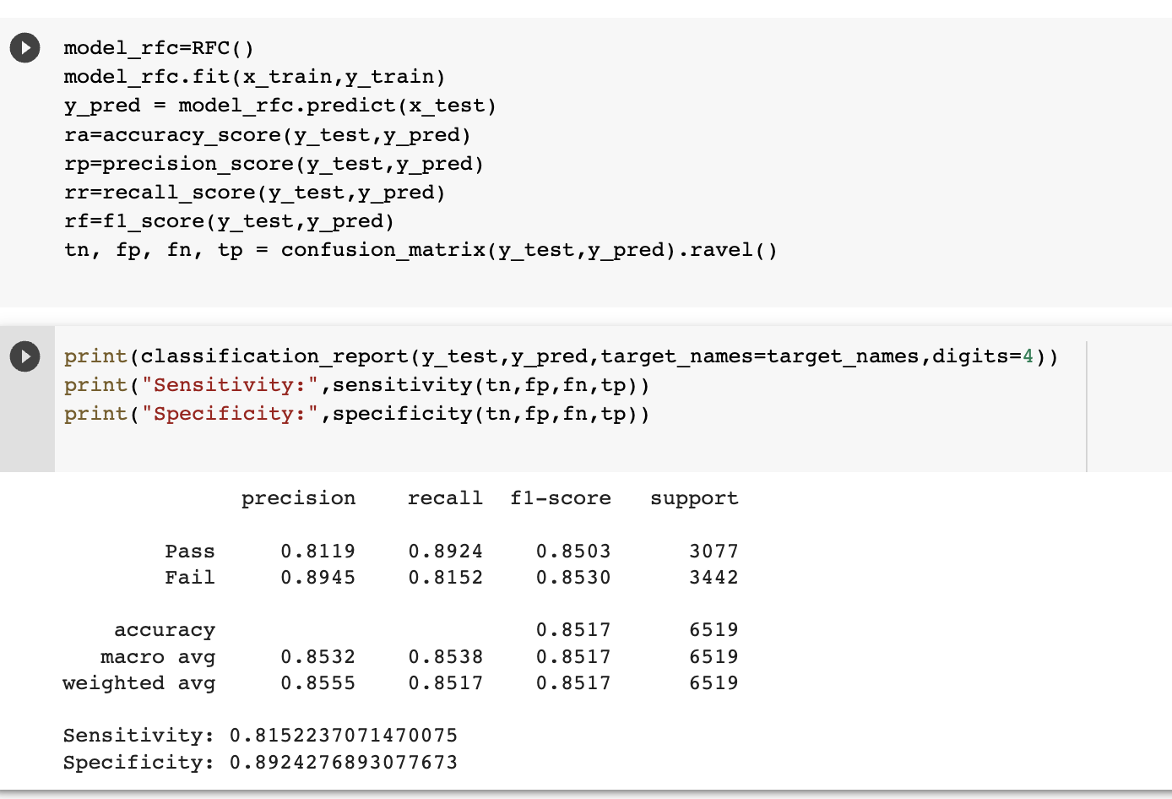
Fig 8 Random Forest

Slide 21
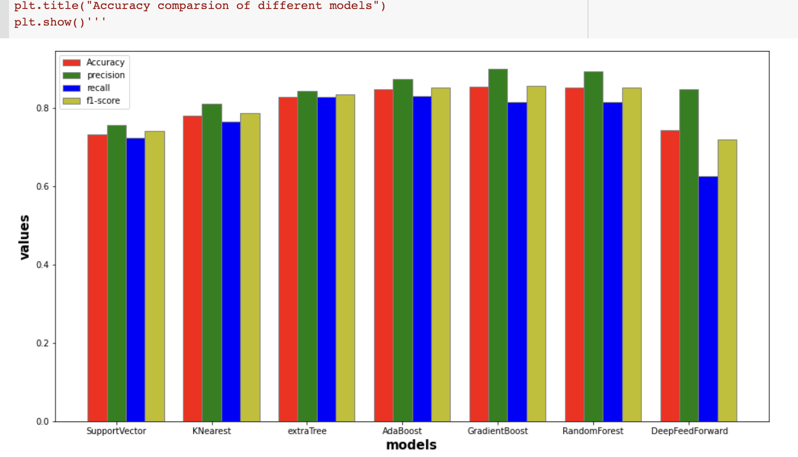
Fig 9 Comparison of Models(Accuracy,precision,recall,f1-score)

Slide 22
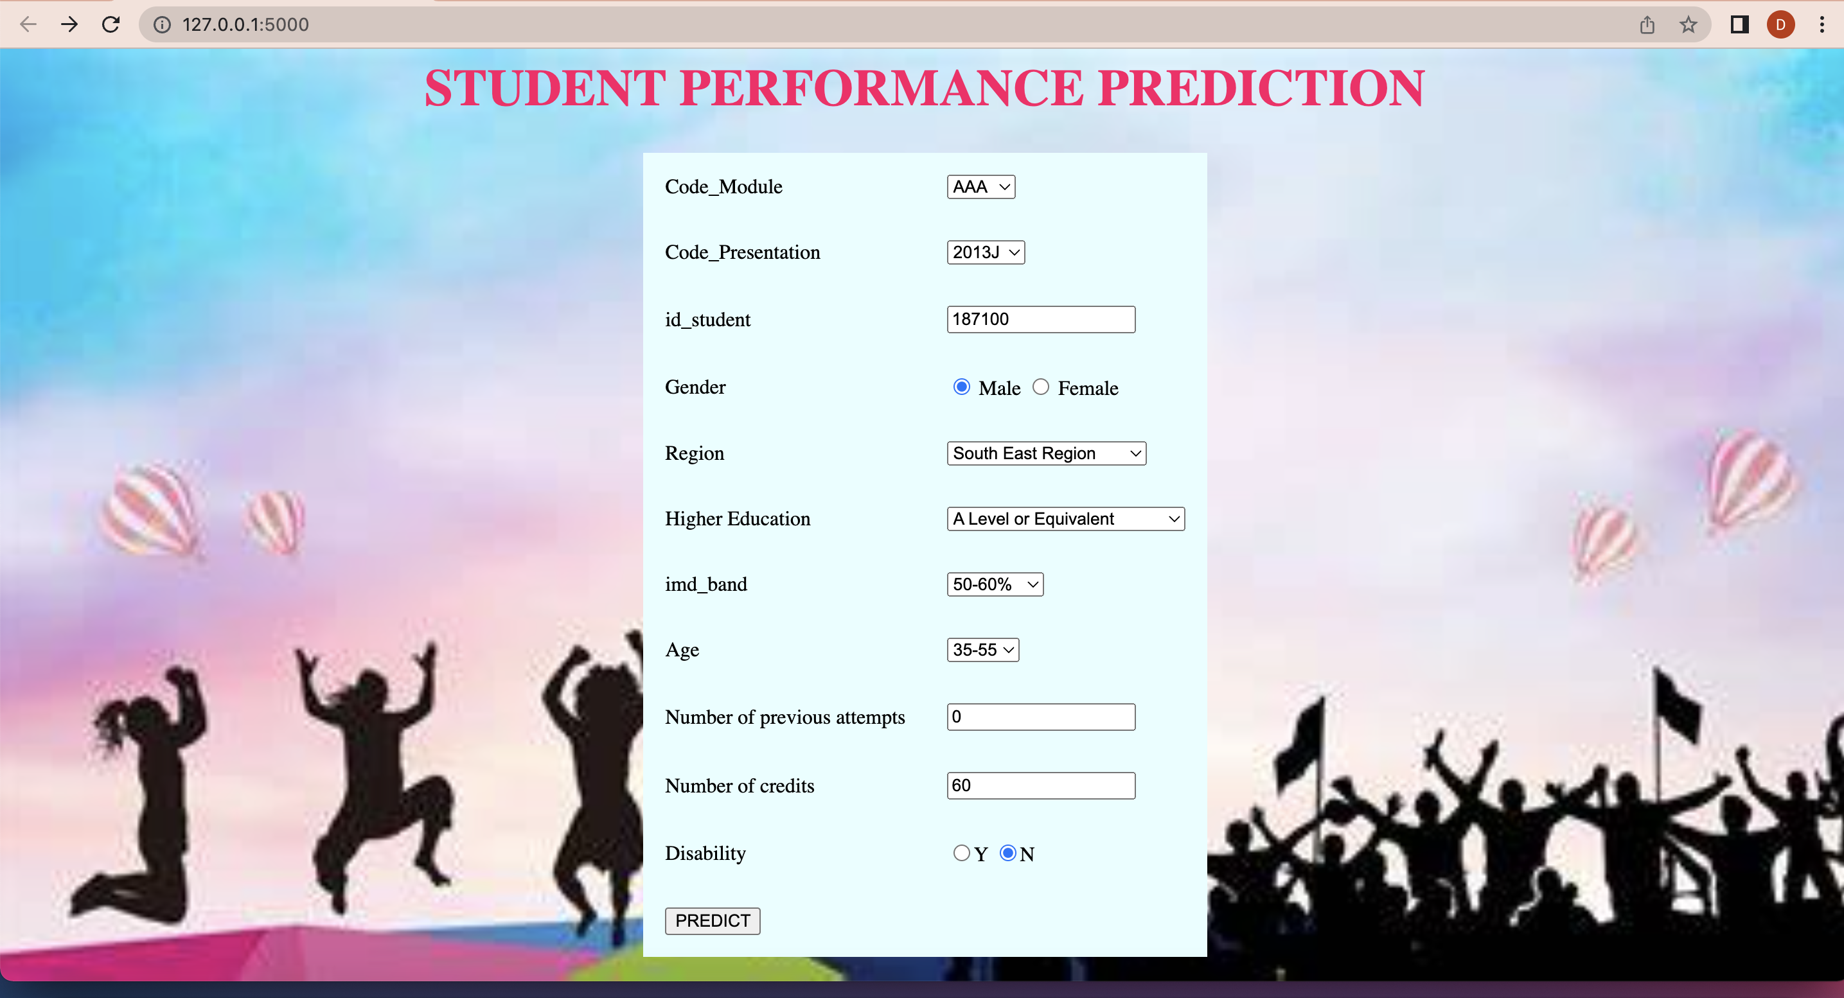
Fig 10 Uploading of Data Screen

Slide 23
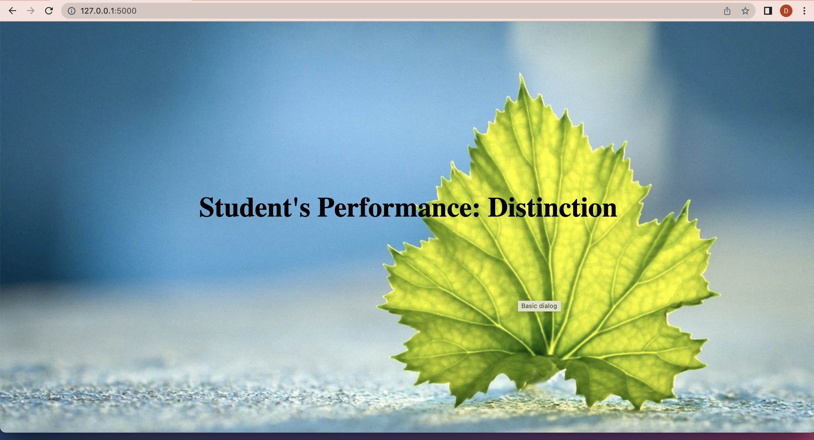
Fig 11 Output Screen

Slide 24
CONCLUSION
The purpose of the study was the prediction of risk of students at different course lengths by machine learning.
The study and employed four classification metrics for evaluations. The study showed that there was a significant improvement in the performance of models when they used the clickstream data and assignment scores.
Random Forest predictive model (85%) with the highest performance scores selected for predicting student’s performance.
Out of many variables clickstream data and assessment scores have the most significant impact on the final result

Slide 25
FUTURE WORK
The prediction accuracy of machine learning models can be increased by using various other algorithms like Decision Tree, Random Forest, Adaboost, XGBoost, SVC, Naïve Bayes, KNN, Logistic Regression a and deep learning methods.
This can be made into mobile application so that students can track their performance and improve their scores.

Slide 26
Thank You

